Slide 1

Predict Student Performance in Secondary Education (High school).
Project Supervisor: Mr. Amandeep Singh k , B.tech , M.tech, (Phd) .,
Name of the Student: Mr. Sujeeth S.R
Register Number: 39110982

Slide 2
Presentation Outline
Course Certificate
Introduction
Objectives
System Architecture / Ideation Map
Module Implementation
Application Snapshots
Results and Discussions
Conclusion & Future work
References

Slide 3
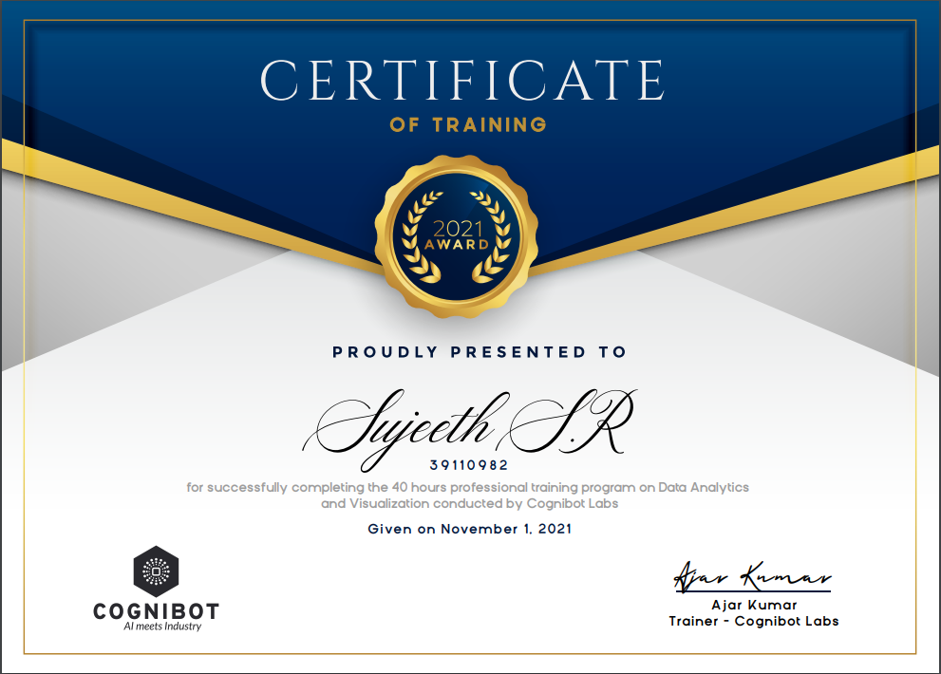
Course Certificate

Slide 4
Introduction
The aim of this study is to predict the students’ final grades to support the educators to take precautions for the children at risk.
This presentation focuses on prediction of student performance i.e the successes of the students at the end of the acedamic year by using the student data obtained from secondary education of two Portuguese schools.
A number of data pre-processing processes were applied to increase the accuracy rate of the prediction model.

Slide 5
Objectives
The study will compare the performance and efficiency of ensemble techniques that make use of different combinations of data sources with that of base classifiers with a single data source Design/methodology/approach.
The scope of the present study is limited in the investigation of the effects of cognitive factors (i.e., the above-stated eight predictor variables) on student academic performance in secondary school students.
Data Analysis can help us to obtain useful information from data and can provide a solution to our queries. Further, based on the observed patterns we can predict the outcomes of different business policies.

Slide 6
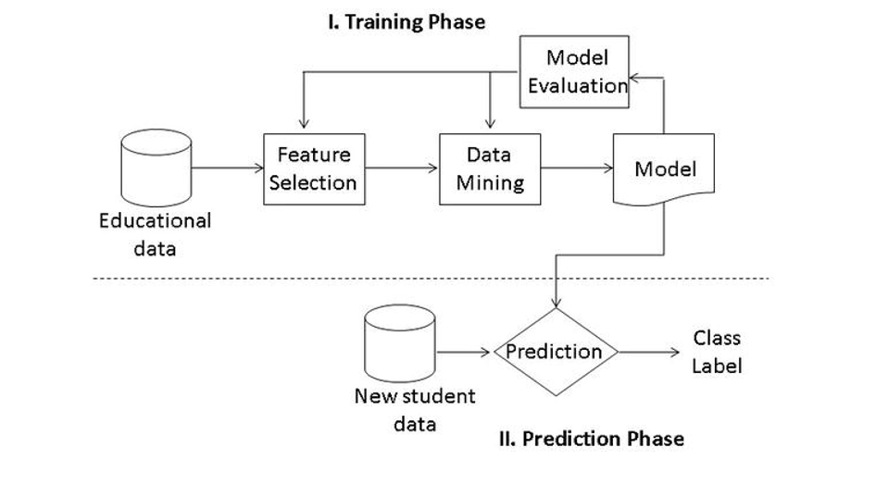
System Architecture / Ideation Map

Slide 7
Project Implementation
Initially , we import the libraries from matplot
Then we import the data set which is given
We define x and y , where x is the given information and y is the prediction asset ( in this case y is the prediction of student performance)
Now we use the scikit-learn module train_test_split, which is used for splitting the training and testing parts.
The next step is to train the model on the training set
Then we predict the test set result
Evaluate the model and then plot the result
Predict the values

Slide 8
Methodology
The increase in digitalization caused us to have plenty of data in every field. Having too much data is getting worth if we know how to use it. Data mining aims to access knowledge from data using various techniques. With data mining, it becomes possible to establish the relationships between the data and make accurate predictions for the future. One of the application areas of data mining is education.
Data mining in education is the field that allows us to make predictions about the future by examining the data obtained so far in the field of education by using data mining techniques. There are basically three data mining methods: classification, clustering, and association rule mining. In this study, we focus on the classification task.
The methods to be used in data mining may differ depending on the field of study and the nature of the data we have. In this study, three well-known classification algorithms (decision tree, random forest, and naive Bayes) were employed on the educational datasets to predict the final grades of students.

Slide 9
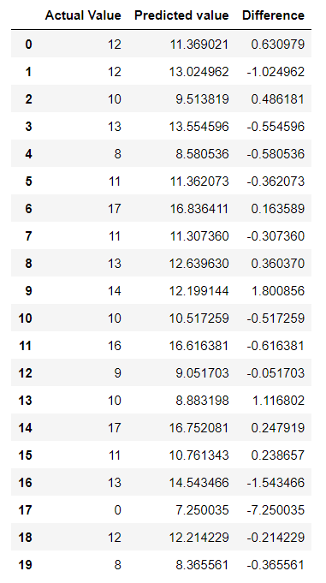
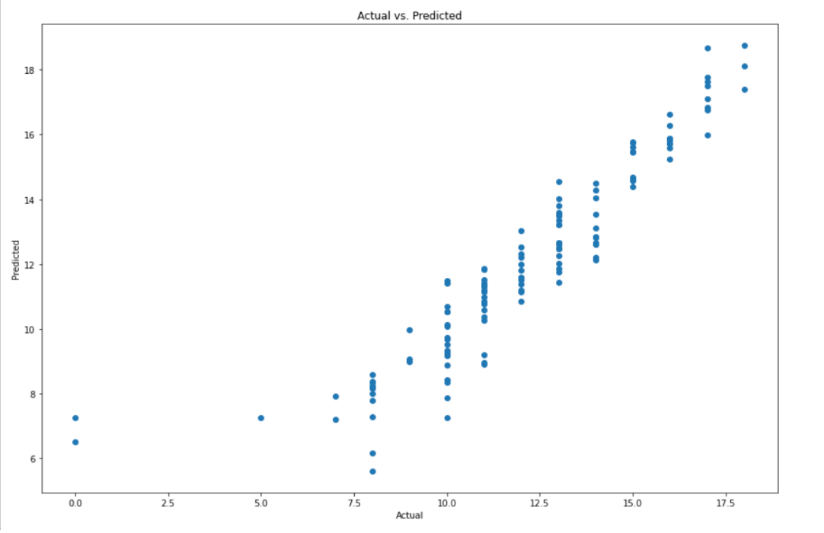
Results and Discussion
We take a compression between the predicted values of the dependent variable and the original values of variable
Overall, better accuracy rates were achieved with the binary class method for both mathematics and Portuguese datasets.

Slide 10
Conclusion and Future works
This paper proposes the application of data mining techniques to predict the final grades of students based on their historical data. Three well-known classification techniques (decision tree, random forest, and Naive Bayes) were compared in terms of accuracy rates.
Pre-processing operations on the dataset, categorizing the final grade field into five and two groups, increased the percentage of accurate estimates in the classification.
The wrapper feature subset selection method was used to improve the classification performance.
Overall, better accuracy rates were achieved with the binary class method for both mathematics and Portuguese datasets.

Slide 11
References
[1] Breiman L.; Friedman J.; Ohlsen R.; and Stone C., 1984. Classification and Regression Trees. Wadsworth, Monterey, CA.
[2] Eurostat, 2007. Early school-leavers. Http://epp.eurostat.ec.europa.eu/.
[3] Hastie T.; Tibshirani R.; and Friedman J., 2001. The Elements of Statistical Learning: Data Mining, Inference, and Prediction. Springer-Ve
[4] Minaei-Bidgoli B.; Kashy D.; Kortemeyer G.; and Punch W., 2003. Predicting student performance: an application of data mining methods with an educational web-based system. In Proc. of IEEE Frontiers in Education. Colorado, USA, 13–18. rlag, NY, USA.

